Slide 1
Simulation & Modeling 2021-2022
LAB 2

Slide 2
Teams and Materials
Registration Form:
https://docs.google.com/forms/d/1K8MFvos8t-Q8fXRjWgzHkJeD0bfWXH-1H1wtSpWPXdY/edit?usp=sharing
Tasks Templates:
https://drive.google.com/drive/folders/1MTW6PAxF9Q2VEHiFzxXWAYFCELDcfO3I?usp=sharing

Slide 3
Task (1) Delivery Rules
Task support will be held next week
Saturday 30-10-2021 : From 12:00 to 4:00 on Csys Lab
Thursday 2-11-2021 : From 10:00 to 2:00 on CS Lab
Task delivery after two weeks.
Every team will be assigned a time slot for the task delivery. Teams should commit to their assigned time slot
Any delay will not be accepted.
Each team member should be there for the delivery at least once.
Cheating Policy
First Incident: -10% from the yearwork grades
Second Incident: -50% from the yearwork grades
Third Incident: -100% from the yearwork grades
Notes:
Task delivery time will be sent

Slide 4
Multi-channel Queue
THE CALL CENTER

Slide 5

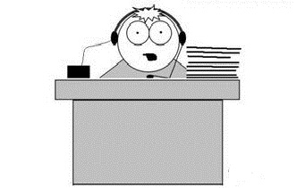
Multi-channel Queue
Baker
Able

Slide 6

Multi-channel Queue

Slide 7
Multi-channel Queue
Baker
Able

Slide 8
Multi-channel Queue

Slide 9

Multi-channel Queue
Baker
Able

Slide 10
Multi-channel Queue

Slide 11
Multi-channel Queue
Baker
Able

Slide 12
Multi-channel Queue - Arrival of a Customer
Arrival Event
Is Able Idle?
Yes
Customer enters service
No
Customer enters queue for service
No
Is Baker Idle?
Yes
Customer enters service
Unit-entering-system flow diagram

Slide 13
Multi-channel Queue - Departure of a Customer
Departure Event
Begin server idle time
No
Another customer waiting?
Yes
Remove the waiting customer from the queue
Begin servicing the customer
Service-just-completed flow diagram

Slide 14
Multi-channel Queue
We need to the system measures of system performance in terms of:
The efficiency of Able.
The efficiency of Baker
The average caller delay.

Slide 15
Multi-channel Queue - System Design
Server Selection: [How to select a server when both servers are available?]
Highest Priority
Each server should be assigned a priority
When a customer arrives, it enters the available server having the highest priority
Random
Choose any server of the available servers
Least utilization [Bonus]
When a customer arrives, calculate the utilization of the available servers
The customer enters the server having the least utilization, i.e. the server that worked the least amount of time since the system has started running.

Slide 16
Multi-channel Queue - System Design
System Variables
Arrival Time(i) = T_{i}
Interarrival Time(i) = A_{i} = T_{i} – T_{i-1}
Service time(i) = S_{i}
Waiting Time(i) = D_{i}
Departure Time (i) = C_{i} = T_{i} + D_{i} + S_{i}
S and A are stochastic variables (generated according to probability distribution)

Slide 17
Multi-channel Queue - System Input
Inter-arrival time distribution
Number of servers
Service time distribution for each server
Server Selection method (priority, random, least utilization[BONUS])
Stopping Condition
Maximum Number of customers
Simulation end time

Slide 18
Multi-channel Queue - System Output
Results table including these columns:
Customer No
Random Digit for inter-arrival time
Inter-arrival time
Arrival time (Clock Time)
Random Digit for service duration
Service duration
Server Index
Time Service Begins
Time Service Ends (Departure)
total delay time for this customer (Time in queue)
N.B: Assume Server 1 has higher priority

Slide 19
Sample Testcase

Slide 20
Multi-channel Queue - Sample Input
Interarrival Distribution of calls
Interarrival Time | Probability | Cumulative probability | Rang
1 | 0.25 | 0.25 | 01-25
2 | 0.40 | 0.65 | 26-65
3 | 0.20 | 0.85 | 66-85
4 | 0.15 | 1 | 86-00

Slide 21
Multi-channel Queue - Sample Input
Able’s Service Time distribution
Service Time | Probability | Cumulative probability | Range
2 | 0.30 | 0.30 | 1-30
3 | 0.28 | 0.58 | 31-58
4 | 0.25 | 0.83 | 59-83
5 | 0.17 | 1 | 84-00

Slide 22
Multi-channel Queue - Sample Input
Baker’s Service Time distribution
Service Time | Probability | Cumulative probability | Range
3 | 0.35 | 0.35 | 1-35
4 | 0.25 | 0.60 | 36-60
5 | 0.20 | 0.80 | 61-80
6 | 0.20 | 1 | 81-00

Slide 23
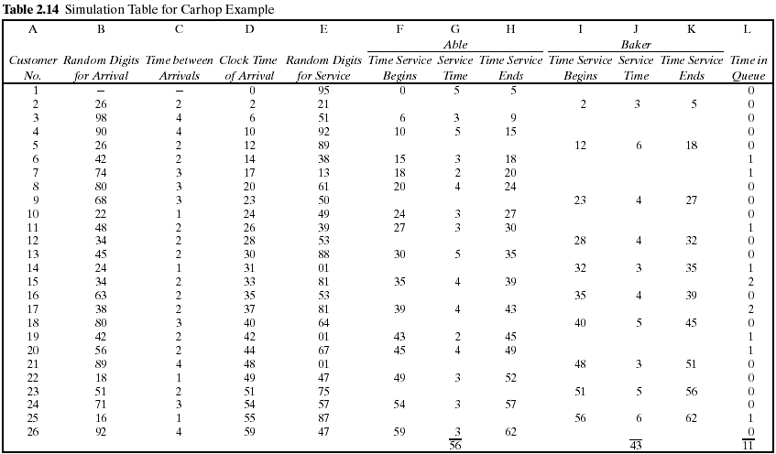
Multi-channel Queue - Sample Output

Slide 24
System Output - Performance Measures
Calculate the Measures of Performance for the system:
Average waiting time (in the queue).
Maximum queue length.
Probability that a customer wait in the queue.
Per Server:
Average service time per server.
Utilization of each server
Probability that a server is in idle state.
Do we need extra server? Why?!!

Slide 25
System Output - Performance Measures
Measure system performance by calculating the following variables:
Maximum queue length during simulation runtime.
Notes:
Total number of customers : number of customers that have entered the server
Total time customers waited in queue : the sum of delay time of the customers that entered the server
Number of customers who waited: number of customers that have entered the server and having delay time > 0

Slide 26
System Output - Performance Measures Per Server
Measure servers performance by calculating the following variables:
Notes:
Total number of customers : number of customers that have entered the server
Total time customers waited in queue : the sum of delay time of the customers that entered the server
Number of customers who waited: number of customers that have entered the server and having delay time > 0

Slide 27
Multi-channel Queue – Graph
Required Chart
Server Busy Time [One for every server]
X-axis : time
Y- axis : it has a value of 1 if the server is busy or zero if the server is idle

Slide 28
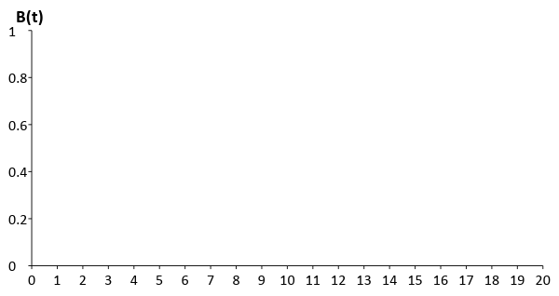
Server Busy Time – Server 1
Busy
Idle
Time

Slide 29
Server Busy Time – Server 2
Busy
Idle
Time

Slide 30
Task (1) Deliverables
The complete simulation table for 100 customers (refer to slide 22)
The performance parameters calculated from the simulation table (refer from slide 23 to 25)
The graph (refer from slide 26 to 28)

Slide 31
More Notes
GUI is mandatory.
Reading data from files and view the data is mandatory.
Well OOP design is mandatory.
Bonus: Least Utilization

Slide 32
Template Walkthrough

Slide 33
Multi-channel Queue - Sample Input
Interarrival Distribution of calls
Interarrival Time | Probability | Cumulative probability | Rang
1 | 0.25 | 0.25 | 01-25
2 | 0.40 | 0.65 | 26-65
3 | 0.20 | 0.85 | 66-85
4 | 0.15 | 1 | 86-00

Slide 34
Multi-channel Queue - Sample Input
Able’s Service Time distribution
Service Time | Probability | Cumulative probability | Range
2 | 0.30 | 0.30 | 1-30
3 | 0.28 | 0.58 | 31-58
4 | 0.25 | 0.83 | 59-83
5 | 0.17 | 1 | 84-00

Slide 35
Multi-channel Queue - Sample Input
Baker’s Service Time distribution
Service Time | Probability | Cumulative probability | Range
3 | 0.35 | 0.35 | 1-35
4 | 0.25 | 0.60 | 36-60
5 | 0.20 | 0.80 | 61-80
6 | 0.20 | 1 | 81-00

Slide 36
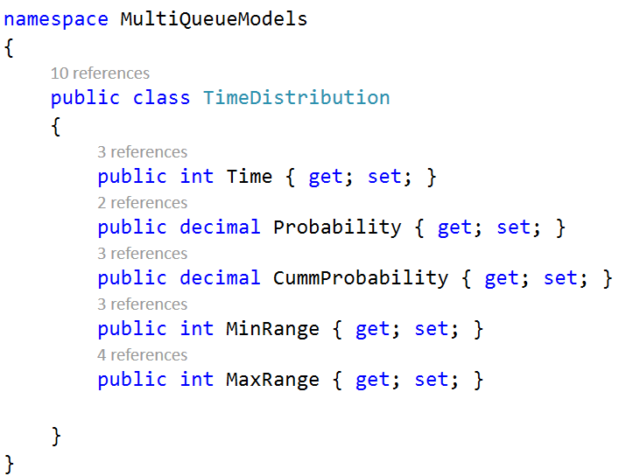

Slide 37
System Output - Performance Measures Per Server
Measure servers performance by calculating the following variables:
Notes:
Total number of customers : number of customers that have entered the server
Total time customers waited in queue : the sum of delay time of the customers that entered the server
Number of customers who waited: number of customers that have entered the server and having delay time > 0

Slide 38
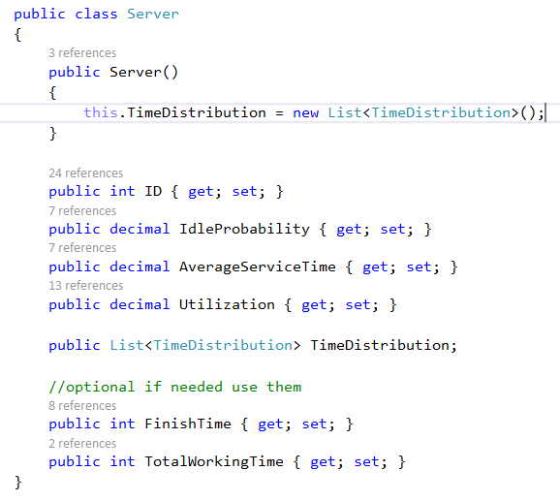
Notes:
ID is One based

Slide 39
Multi-channel Queue - Sample Output

Slide 40
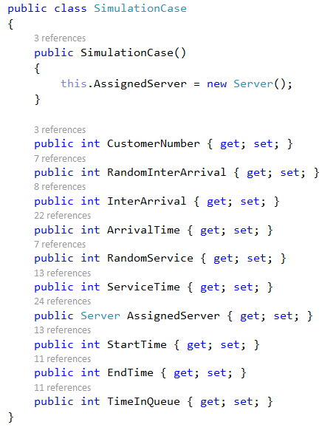

Slide 41
System Output - Performance Measures
Measure system performance by calculating the following variables:
Maximum queue length during simulation runtime.
Notes:
Total number of customers : number of customers that have entered the server
Total time customers waited in queue : the sum of delay time of the customers that entered the server
Number of customers who waited: number of customers that have entered the server and having delay time > 0

Slide 42
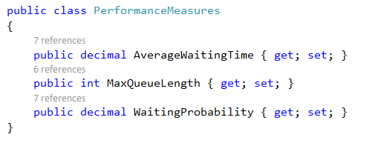

Slide 43
Multi-channel Queue - System Input
Inter-arrival time distribution
Number of servers
Service time distribution for each server
Server Selection method (priority, random, least utilization[BONUS])
Stopping Condition
Maximum Number of customers
Simulation end time

Slide 44
Multi-channel Queue - System Output
Results table including these columns:
Customer No
Random Digit for inter-arrival time
Inter-arrival time
Arrival time (Clock Time)
Random Digit for service duration
Service duration
Server Index
Time Service Begins
Time Service Ends (Departure)
total delay time for this customer (Time in queue)
N.B: Assume Server 1 has higher priority

Slide 45
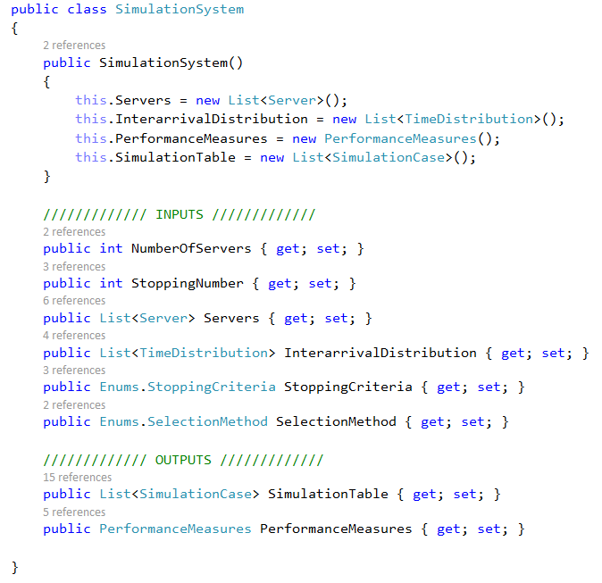

Slide 46
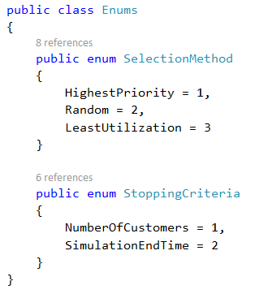

Slide 47
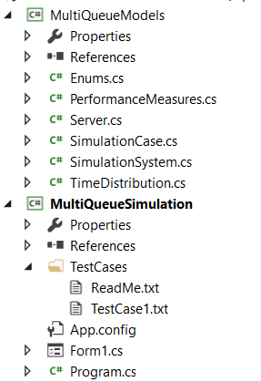
Model Project
Layer where project entities are defined
Windows Form Project
Main project where forms are created to input/output data

Slide 48
Template Walkthrough
You are committed to use the provided template in C#.
You can add constructor if needed but don’t override the default one.
You are provided with only one testcase.
You are given a testcase to run that will provide with a message
Success message if your code runs correctly.
Error message describing the failed part.
Running using testcases
Your system object

Slide 49
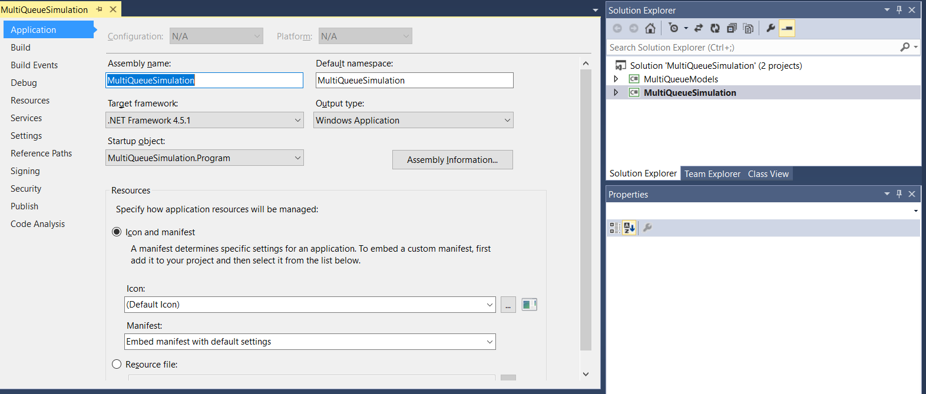
Note
Error: The type or namespace name '' could not be found (are you missing a using directive or an assembly reference?
Solution: Make sure that your program target framework is .net framework 4.5.1.

Slide 50
Thank you…

